Slide 1
Nfinity Games Portal Sample

Slide 2
Portal Components
Index
Portal Main Page Sample
Portal Main Page Components
Nfinity Games Portal User Bar
Login
Register
Facebook Login
Games
Portal Bars
Rotating Banners
Portal Menu
Server Time : Server Time of All Nfinity Games Products
Login/Register
Charge NG
Portal Content
Quick Charge
Game List
Social Media Pages
Events/Notices
Customer Support
Charge NG
Foot Part
Web Site Maps
Foot Bar
Point Blank Turkey Web Site (After Portal has been applied)

Slide 3
Portal Main Page Sample

Slide 4
Portal/Main Page
Nfinity Games Portal User Bar
GAMES
Login
Facebook Login
Register
Main Page | Download Center | News | Forum | Ticket System | Charge NG
Server Time
ROTATING BANNERS
CHARGE
NG
LOGIN
REGISTER
| Point Blank | | Troy | |Backgammon |
CHARGE NG
Youtube | Facebook | Twitter
Quick Charge NG
FPS
Event | Notice
RPG
Board
Customer Support
GAMES | FORUMS | NEWS | SUPPORT | USER
About Us | Privacy Policy | Terms of Use | Contact Us

Slide 5
Portal Main Page/User Bar

Slide 6
Main Page/User Bar
4
1
3
2
Nfinity Games Portal User Bar
GAMES
Login
Facebook Login
Register
Nfinity Games Portal User Bar
Login: Login
Register : New Registration
Facebook Login : Login via Facebook
Games : All Games of Nfinity Games

Slide 7
Portal Main Page/Portal Bars

Slide 8
Main Page/Portal Bars
Main Page | Download Center | News | Forum | Ticket System | Charge NG
2
Server Time
3
ROTATING BANNERS
CHARGE
NG
LOGIN
REGISTER
1
5
4
Portal Bars
Rotating Banners : Rotating Banners of Nfinity Games Announcements
Portal Menu :
Server Time : Server Time of All Nfinity Games Products
Login/Register : After Login, it’ll be user profile
Charge NG

Slide 9
Portal Main Page/Portal Content

Slide 10
Main Page/Portal Content
| Point Blank | | Troy | |Backgammon |
CHARGE NG
Youtube | Facebook | Twitter
2
3
Quick Charge NG
FPS
1
Event | Notice
RPG
4
Board
Customer Support
6
5
Portal Content
Quick Charge : Quick NG Charge Menu
Game List : Nfinity Game List / Web Site Links / Introduction
Social Media Pages : Nfinity Games Portal Social Media Pages such as Youtube, Facebook etc.
Events/Notices : Event/Notices List of Nfinity Games products
Customer Support : Customer Support Menu
Charge NG

Slide 11
Portal Main Page/Foot Part

Slide 12
Main Page/Foot Part
GAMES | FORUMS | NEWS | SUPPORT | USER
1
About Us | Privacy Policy | Terms of Use | Contact Us
2
Foot Part
Web Site Maps : Game List, Forum List, News , CS , User Profile
Foot Bar : About Us , Privarcy Policy, Terms of use, Contact Us

Slide 13
Point Blank Web Page Sample (After Portal has been applied)

Slide 14
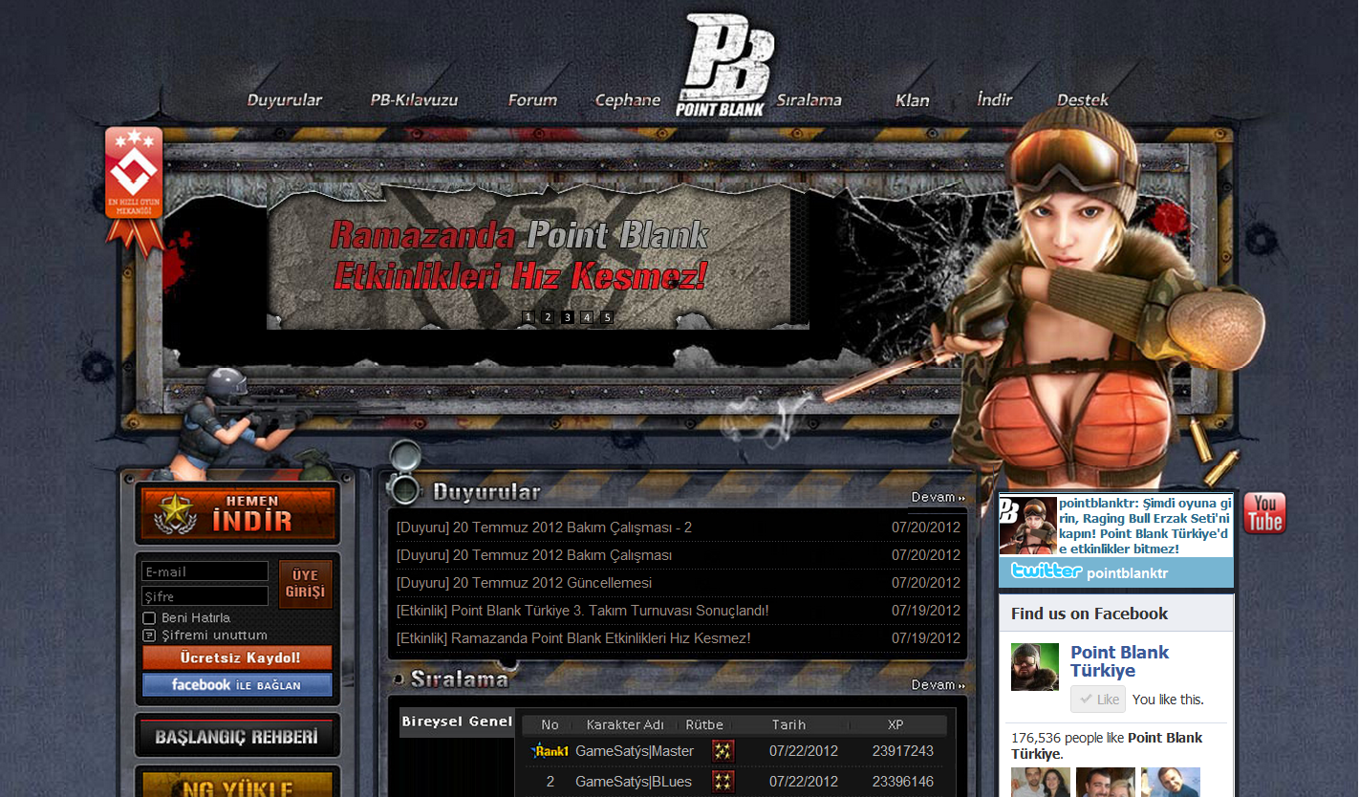
Portal/Point Blank
Nfinity Games Portal User Bar
Social Media Links
Login
Facebook Login
Register
Charge NG

